Slide 1
Independent Monitoring &
Reporting of the 2030 Agenda
Enabling an Inclusive Transformation Implementing the Sustainable
Development Goals in Sri Lanka
Executive Director, Centre for Environment and Development (CED)
Chairman, Global Sustainability Solutions (GLOSS)
Mobile:+94777372206 - Fax: +94 112768459
Web: www.glossolutions.org –
Email: uchita@sltnet.lk
Uchita de Zoysa

Slide 2
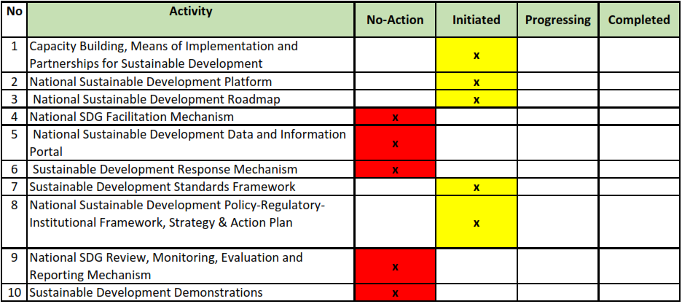
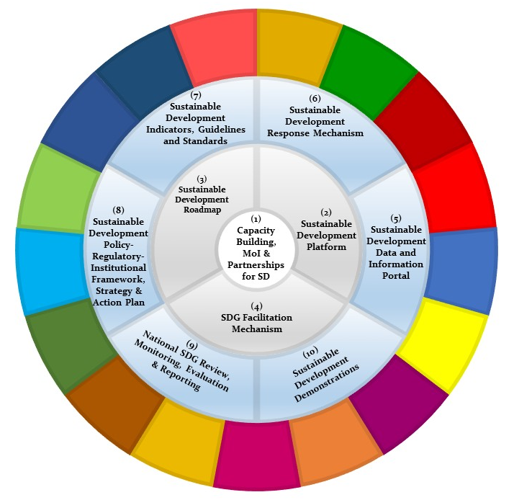
INACTION: Low Mainstreaming, Integration and Localising
How can a country deliver a VNR without a proper stocktaking system in place?
Lack of engagement space lead to calling for a Voluntary Peoples Review
Uchita de Zoysa – GLOSS – CED

Slide 3
ALTERNATIVE: Peoples’ Response to the VNR
Facilitate an “Inclusive Transformation” in Sri Lanka
Establish an “Independent Monitoring an Reporting Mechanism” on the implementation of SDGs in Sri Lanka
Conduct a Voluntary Peoples’ Review
Uchita de Zoysa – GLOSS – CED

Slide 4
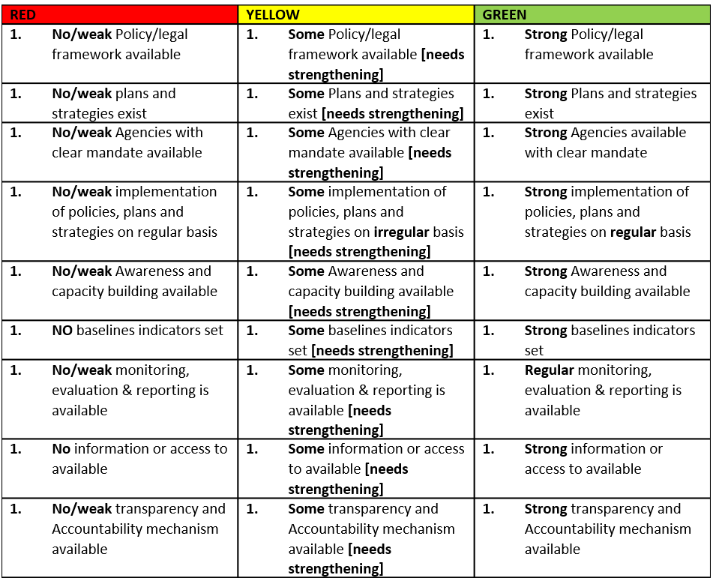
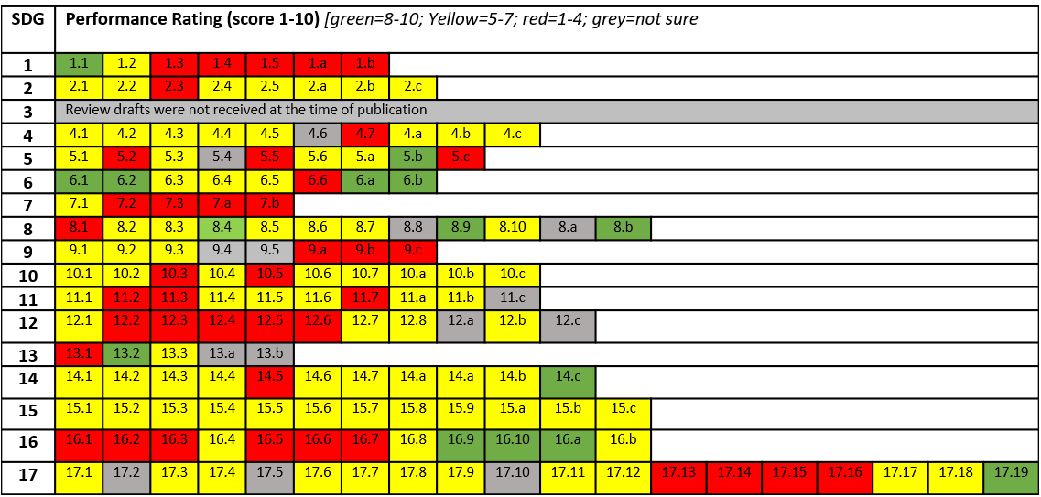
Methodology: An Information Based Independent Assessment
Goal | Indicator | National Baseline Indicator (if available) | Proposed National Baseline Indicator (if different to national baseline indicator and used for rating) | Rationale/ Justification of Rating [based on the proposed baseline indicator] | Performance Rating (score 1-10) [green=8-10; Yellow=5-7; red=1-4; grey=not sure]
Lack of a Policy Coherence planning prevents proper mainstreaming
Lack of Institutional coherence planning proper integration
Lack of a Monitoring, Evaluation, Follow-up & Reporting Mechanism prevents honest stock-taking
Lack of a Sustainable Development Budgeting & a Financing Architecture prevents true commitment to transformation17
Uchita de Zoysa – GLOSS – CED

Slide 5
The Report Card: Status on the Implementation of the SDGs
Lack of a Policy Coherence planning prevents proper mainstreaming
Lack of Institutional coherence planning proper integration
Lack of a Monitoring, Evaluation, Follow-up & Reporting Mechanism prevents honest stock-taking
Lack of a Sustainable Development Budgeting & a Financing Architecture prevents true commitment to transformation
Activity | No | Sub-Activity | Rating
1. Awareness and capacity to implement the SDGs | 1.1 | General Public
 | 1.2 | Educators
 | 1.3 | Parliamentarians
 | 1.4 | Public Officials
 | 1.5 | Local Authorities
 | 1.6 | CSOs & CBOs
 | 1.7 | Private Sector
2.Mainstreaming and integration of SDGs and means of implementation | 2.1 | Institutional coherence and Inter-agency coordination
 | 2.2 | Policy coherence and national SDG framework
 | 2.3 | Integration of the three dimensions of sustainable development
 | 2.4 | Science-Policy interface
 | 2.5 | Localising SDGs
 | 2.6 | Stakeholder engagement
 | 2.7 | Means of Implementation
3. Monitoring, Review, Reporting & Follow-up Mechanism | 3.1 | National SDG Indicators and Baseline Data Framework
 | 3.2 | National SDG Monitoring, evaluation, follow-up and Reporting
 | 3.3 | National Sustainable Development Information
No-Action or very low initiative taken | Some action or some initiative taken | Progressing or high level of success
Uchita de Zoysa – GLOSS – CED

Slide 6
A Performance Assessment: Status on the Implementation of the SDGs
No | Activity | Sub-Activity | Rating
1 | Political commitment | mobilizing whole-of-government action
2 | Policy integration | balancing economic, environmental, and social concerns
3 | Long-term planning horizons | reconciling short- and long-term priorities
4 | Policy effects | addressing potential negative impacts of domestic policies beyond borders
5 | Policy coordination | ensuring coordinated and mutually supporting efforts across sectors
6 | Subnational and local involvement | involving subnational and local levels of government
7 | Stakeholder engagement | engaging key stakeholders beyond government
8 | Monitoring and reporting | using monitoring and reporting systems to inform coherent policy making
The ‘Eight Building Blocks of Policy Coherence for Sustainable Development’ recommended by the OECD is used below as a methodology to assess the state of SDGs in Sri Lanka.
No-Action or very low initiative taken | Some action or some initiative taken | Progressing or high level of success
Uchita de Zoysa – GLOSS – CED

Slide 7
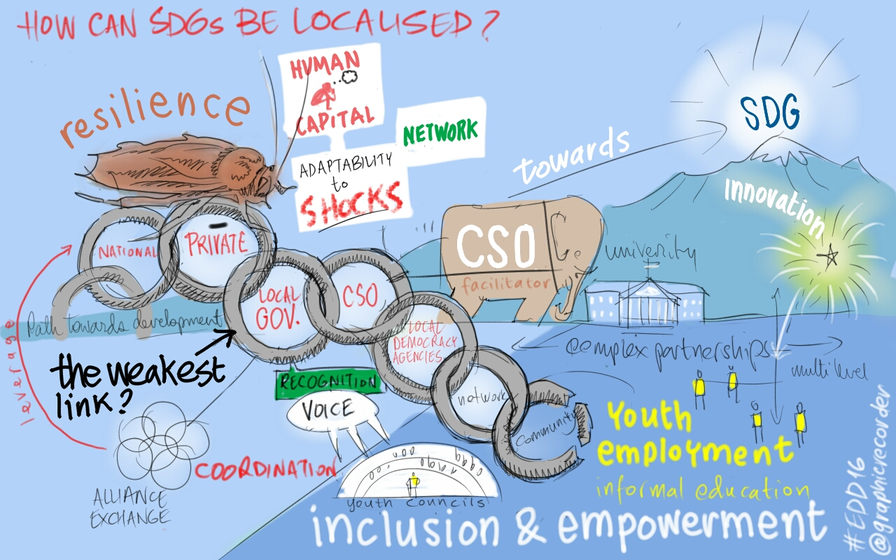
Follow-up: Lack of Momentum and Coordination
Needs methodology and skilled personnel – alternative reports must be able to provide deep and evidence based reviews
Lack of resources – hard to run platforms and independent monitoring, evaluation & reporting
Convergence between national and global platforms - key to getting UN & governments to act
Leaving out national platforms already reported - Focus on new reporting countries – how about the monitoring the commitments made before?
Lack of government interest – Low of stakeholder interest – no stage to act
“Going beyond the simple adaptation of global goals to the local level, localization is about political will, co-creation with our communities and to find solutions at the local level for the global challenges and objectives.”
Uchita de Zoysa – GLOSS – CED

Slide 8
Action: Strengthening the Mobilisation of Private and Sub-National Domestic Investments in Sri Lanka for the 2030 Agenda
Funded by the GIZ 2030 Transformation Fund
1. An analysis of current strategies for financing Sri Lanka’s commitment to 2030 Agenda will be done through expert/stakeholder workshops at national and subnational levels & secondary information analysis including budget 2018 & 2019, national policy framework, provincial development plans/budgets, etc. [Possible VPR 2020]
2. Formulating a domestic resource mobilization framework through a consultative process of key target groups, authorities & experts. The fiscal and regulatory policy issues to align investments by the target groups to implement the 2030 Agenda and will be identified during this phase.
3. Capacity building to implement the domestic resource mobilization framework using modular based training workshops for the key target groups
Uchita de Zoysa – GLOSS – CED

Slide 9
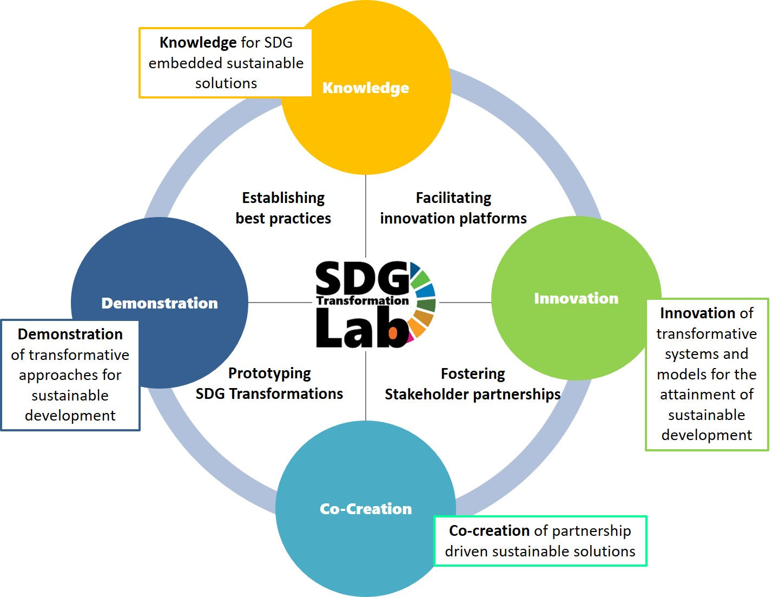
FRAMEWORK: Fostering Transformation Towards Sustainable Development
Knowledge where action-research will fuel publications, trainings and skills development
Innovation where new ideas will be tested and systems designed
Co-creation where partnerships for change are forged and horizontal knowledge shared
Demonstration where success will be championed and expertise diffused for growth and scale.
Chairman, Global Sustainability Solutions (GLOSS) - Principal, SDG Transformation Lab
Executive Director, Centre for Environment and Development (CED)
Web: www.glossolutions.org - Email: uchita@sltnet.lk
Mobile:+94777372206 - Fax: +94 112768459
Uchita de Zoysa

